Slide 1



Speech Recognition - Modelling using KEras -
03-Dec-2019

Slide 2
Agenda
Problem Statement
Dataset
Feature extraction from Speech
Model used for learning
Results
Conclusion
Further studies

Slide 3
Problem statement
Business Problem :
Inference of the digits as said by users on phone
Biometric authentication using the speech dataset

Slide 4
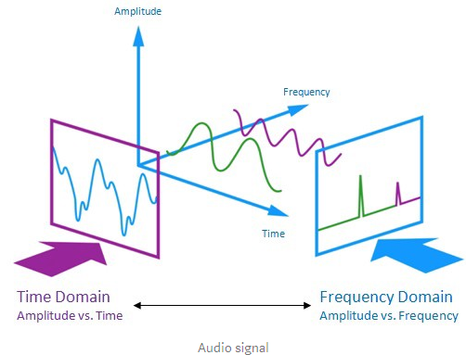
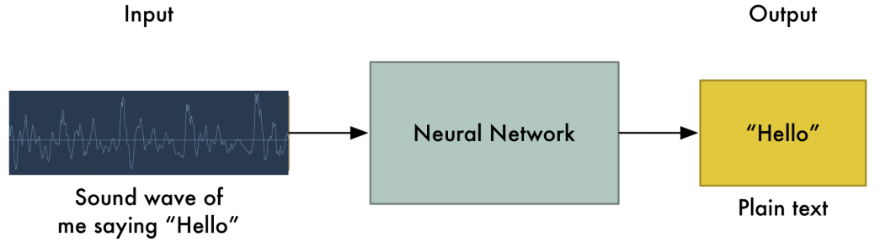
Context – SPEECH Data Processing
Audio signal is a three-dimensional signal in which three axes represent time, amplitude and frequency.
Feed sound recordings into neural network and train to produce text
Problems :
“Heeeelllllllloooooo” vs “Hello!”
Align audio files of various length to a fixed piece
Convert wave into numbers – record the height of wave at equally-spaced points.

Slide 5
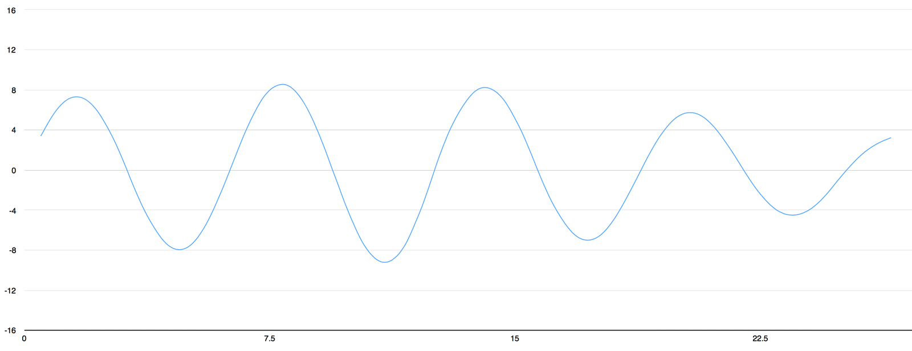
Sampling
Reading thousands of times a second and recording number representing the height of sound wave at that time
CD quality is sampled at 44.1khz ( 44,100 readings per second)
Speech recognition can be done at a sampling rate of 16Khz (16000 times per second)
Here is an example of sample for “Hello”

Slide 6
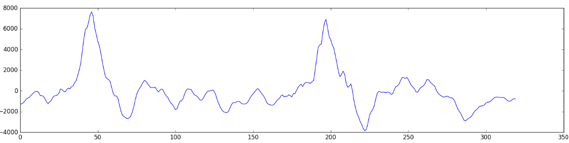
Preprocessing
Each number in array represents sound wave amplitude at 1/16,000th of a second
Instead we start grouping samples into 20 ms chunks ( it would consists of 320 samples)
Still different frequencies mix together to make up complex sound of human speech

Slide 7
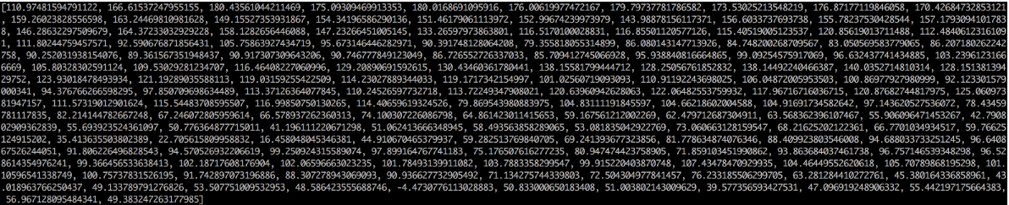
Preprocessing
To make it easier, break apart this complex sound wave into it’s component part.
Break into low-pitched paths, the next-lowest-pitched-parts and so on.
Then add up how much energy is in each of those frequency bands (from low to high), we create a fingerpart of sorts from this audio.
Use Fourier transform , to break apart the complex sound wave into the simple sound waves and then add up to get a sum of energy contained in each one.
End result is a score of how important each frequency range is. Each number below represents energy in each of 50hz band of our 20 ms audio clip

Slide 8
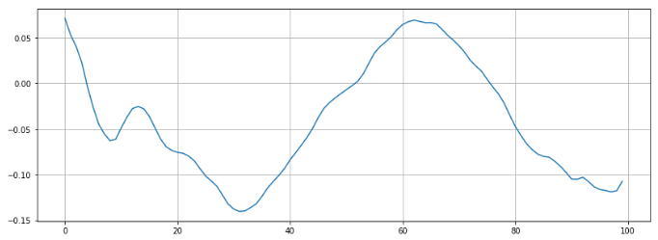
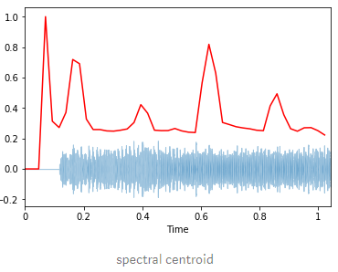
Feature Engineering
Zero Crossing Rate : Rate of sign changes along a signal (ie the rate at which the signal changes from positive to negative or back.
Spectral Centroid : It indicates where the “center of mass” for a sound is located and is calculated as weighted mean of the frequencies present in the sound.

Slide 9
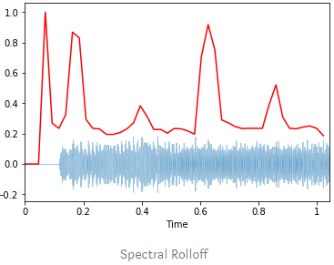
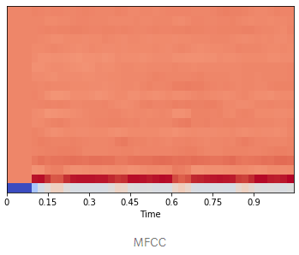
Feature engineering
Spectral Roll off : It’s the frequency below which a specified percentage of the total spectral energy, e.g. 85%, lies.
Chroma : It’s a typically 12-element feature vector indicating how much energy of each pitch class is present in the signal
MFCC (Mel-Frequency Cepstral Coefficients) : These are small set of features (usually about 10–20) which concisely describe the overall shape of a spectral envelope.

Slide 10
Model Pipeline – speaker recognition
Extract sound features
Preprocess and transform the dataset
Apply the Neural Network (Keras)
Tensorflow backend
Prediction
Calculate accuracy matrix
Denselayer(256, relu)
Dropout(0.5)
Denselayer(128, relu)
Dropout(0.5)
Denselayer(64m relu)
Dropout(0.5)
Denselayer(10,softmax)

Slide 11
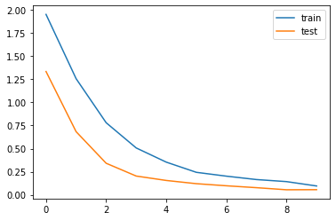
Speaker Recognition Results

Slide 12
Model Pipeline – Digit Recognition
Extract sound features
Preprocess and transform the dataset
Apply the Neural Network (Keras)
Tensorflow backend
Prediction
Calculate accuracy matrix
Denselayer(256, relu)
Denselayer(128, relu)
Denselayer(64m relu)
Dropout(0.5)
Denselayer(10,softmax)

Slide 13
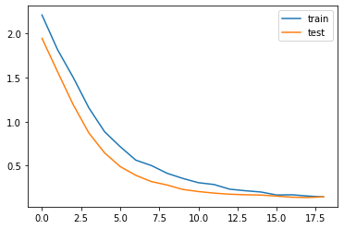
Digit Recognition results

Slide 14
Conclusion

Slide 15
Further recommendation

